Slide 1


Mini Project - Synopsis on
“Decentralized File Storage System Using Blockchain” "Revolutionizing storage, one file at a time."
Dept. of CS&E ( DATA SCIENCE)
Adichunchanagiri Institute of Technology
Chikkamagaluru - 577102
Presented By,
Chaithra G L ( 4AI22CD010 )
Nidhi H Baraker ( 4AI22CD037 )
Shreya M S ( 4AI22CD049 )
Shwetha K M (4AI22CD050 )
Under the Guidance of
Dr. Adarsh M J

Slide 2
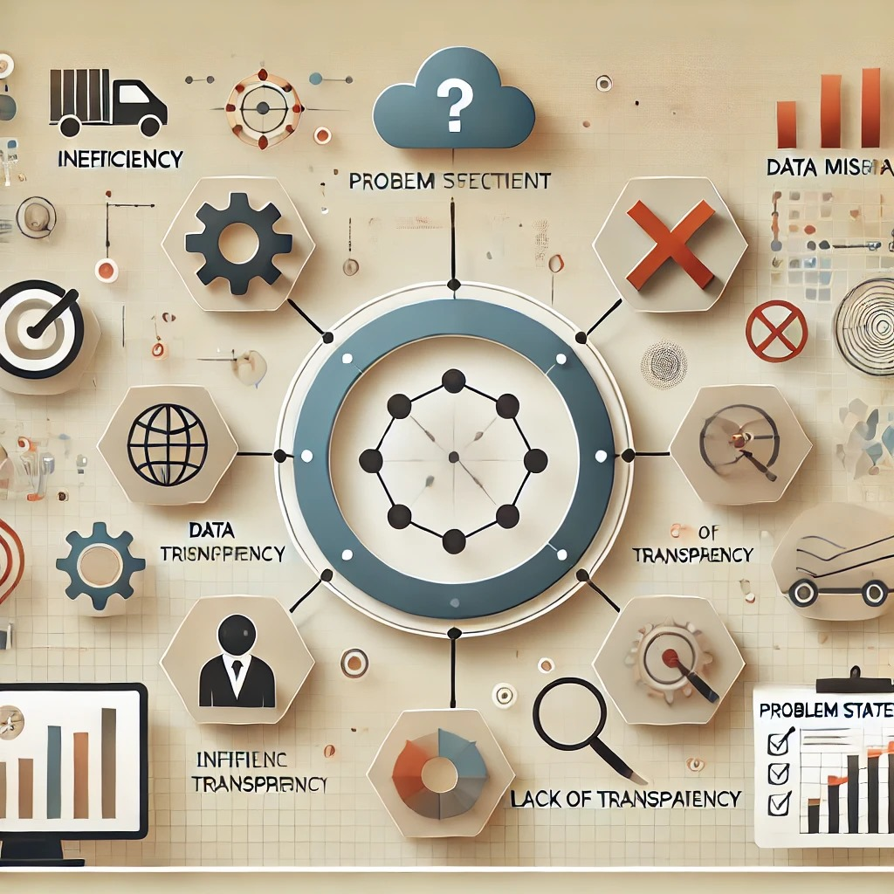
Problem Statement
The Problem:
Centralized storage systems are prone to:
Data breaches
High maintenance costs
Single points of failure
Our Solution:
A decentralized file storage system to ensure:
Data integrity
Transparent access
Cost-effective scalability
Why Decentralization Matters?
Data is stored across multiple nodes, ensuring redundancy,
reliability, and security.

Slide 3
Scope of the project
Focus Areas:
Build a secure, user-friendly interface for file storage.
Utilize IPFS (InterPlanetary File System) and Pinata API for decentralized storage.
Use MongoDB for storing metadata and user-related data securely.
Design a robust backend to ensure seamless data flow.
Key Benefits:
Data Transparency: No hidden data modifications.
Cost Efficiency: Lower maintenance costs compared to centralized systems.
Scalability: Supports users as the network grows.
Impact:Transform how individuals and organizations store and
share data securely.

Slide 4
Project Design
System Components:
Frontend: User interface with login, file upload, and confirmation pages.
Backend: Flask-based API for handling file uploads and Pinata integration.
Storage: Files stored on IPFS via Pinata for decentralized accessibility.
Database: MongoDB for storing metadata such as user information, file details, and IPFS hashes.
System Flow Diagram:
User: Uploads a file through the interface.
Backend: Validates and interacts with the Pinata API.
IPFS: Stores the file, returning an IPFS hash for retrieval.
MongoDB: Stores file metadata (user, date, IPFS hash) for tracking and management.

Slide 5
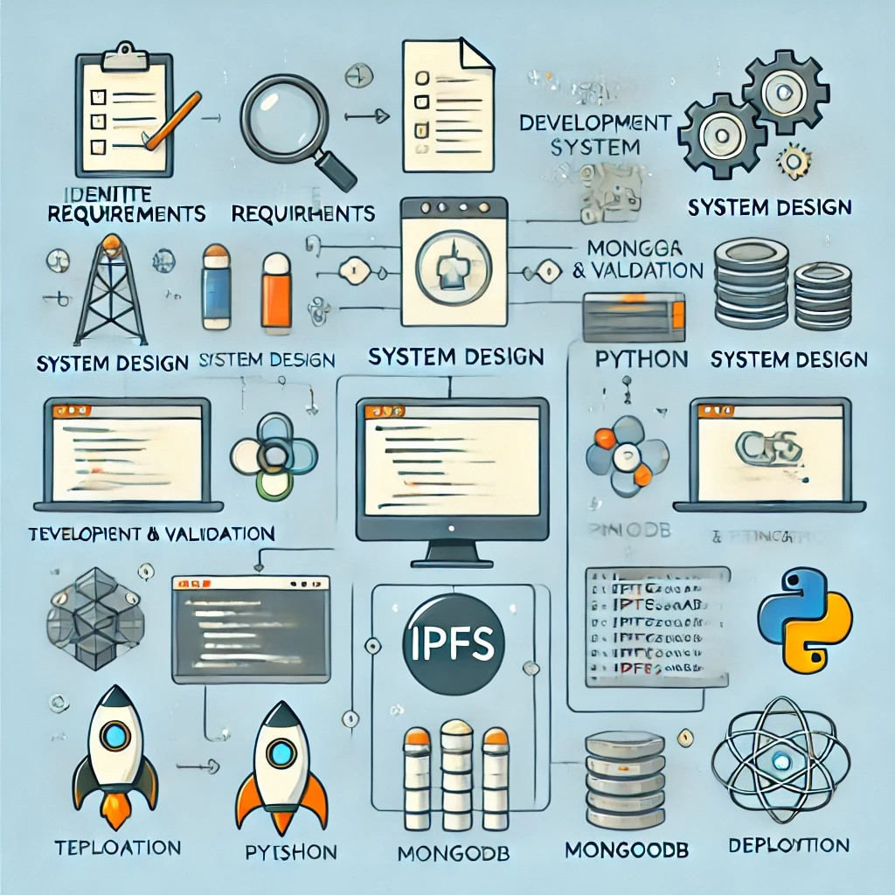
Methodology
Identify Requirements:
Analyze user needs for secure, reliable file storage.
System Design:
Plan the architecture and ensure modular design.
Development Process:
Build frontend interfaces for interaction.
Develop Flask-based backend API for efficient storage operations.
Integrate MongoDB for metadata management.
Testing & Validation:
Conduct rigorous tests to identify and resolve bugs.
Deployment:
Ensure the system runs smoothly and meets user expectations.
Technologies Used:
Frontend: HTML, CSS, JavaScript
Backend: Flask (Python)
Storage: Pinata API, IPFS
Database: MongoDB

Slide 6
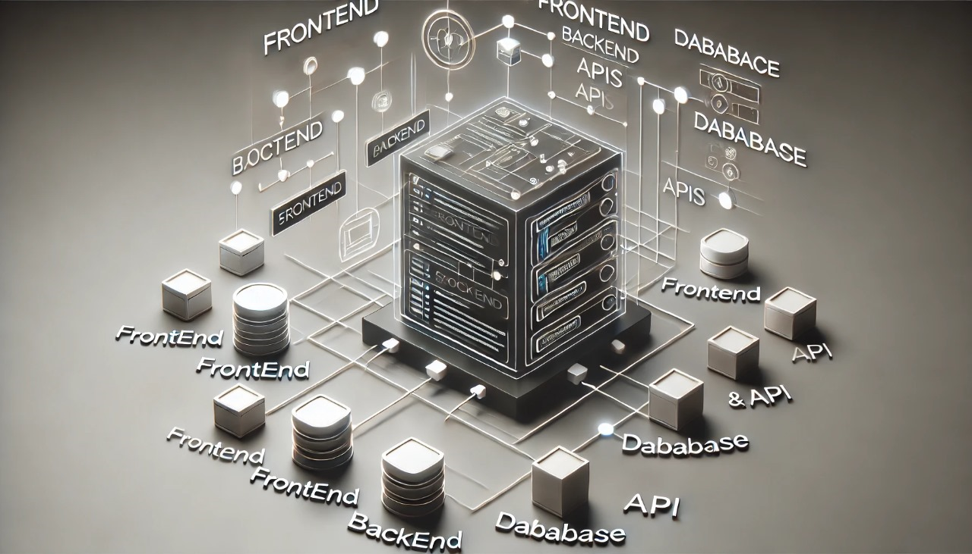
Implementation
Backend:
Integrated Flask with the Pinata API for seamless file uploads.
Enabled secure and reliable communicationbetween frontend
and IPFS and MongoDB.
Frontend:
User-friendly login and file upload pages.Real-time feedback for file upload success or error messages.
Storage:
Files stored on IPFS via Pinata.IPFS hash returned for each file, ensuring immutability and transparency.
Database:
MongoDB used for storing user data, file metadata, and IPFS hashes.Ensures fast and efficient retrieval of file information.

Slide 7
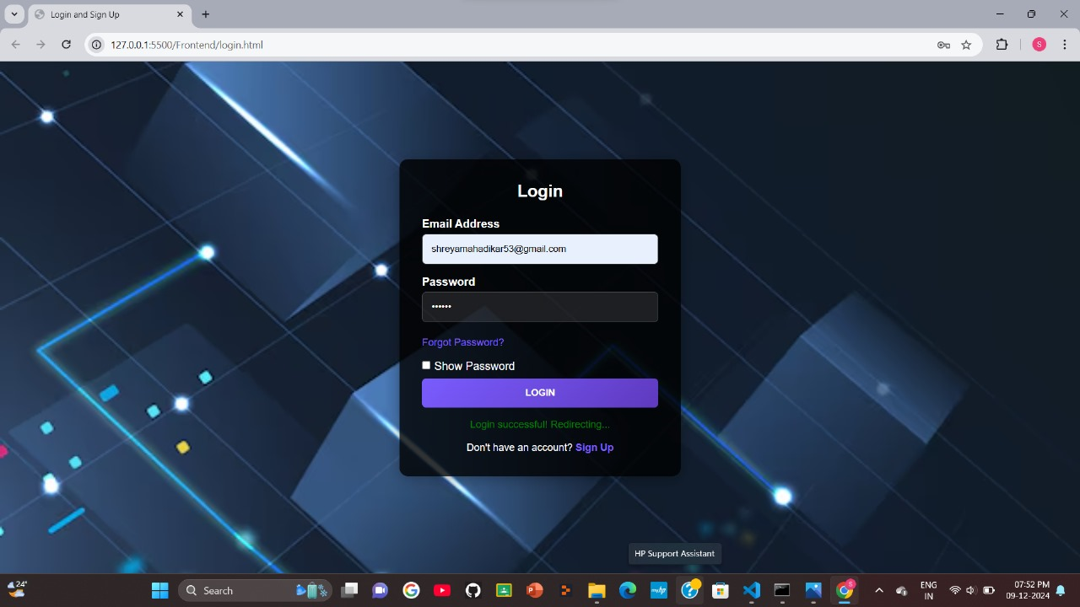
Results
Fig : Login Page

Slide 8
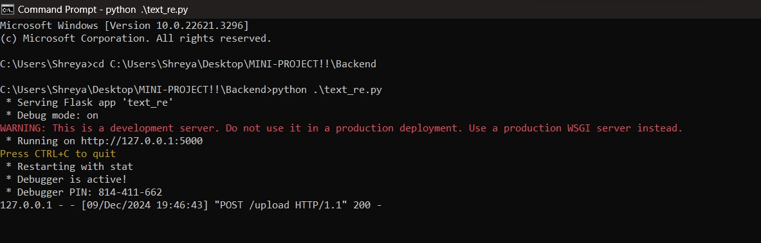
Fig : Flask Development Server Ready for Testing

Slide 9
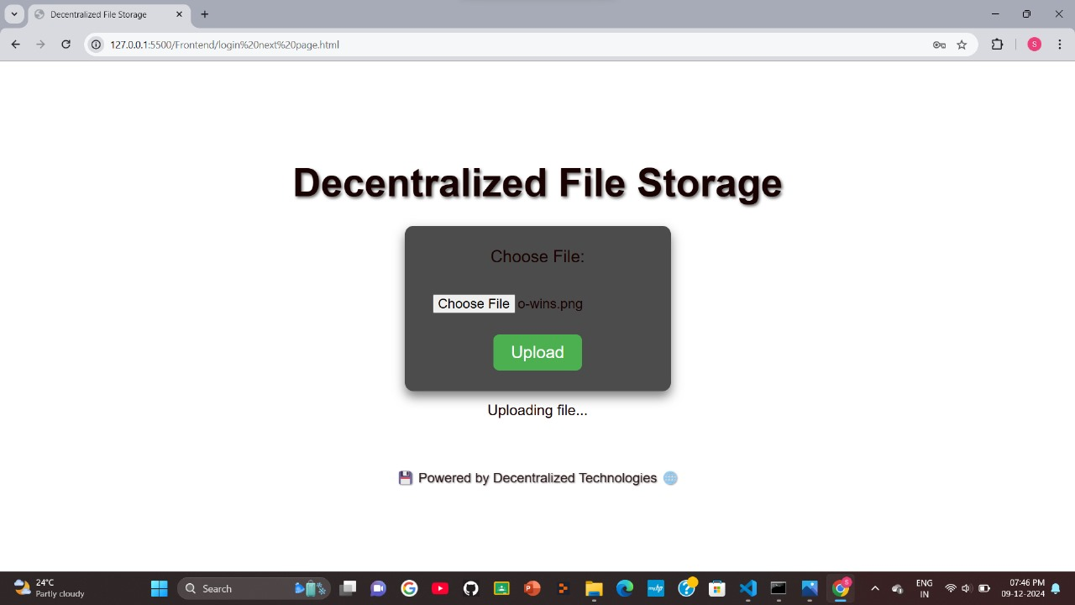
Fig : Uploading File

Slide 10
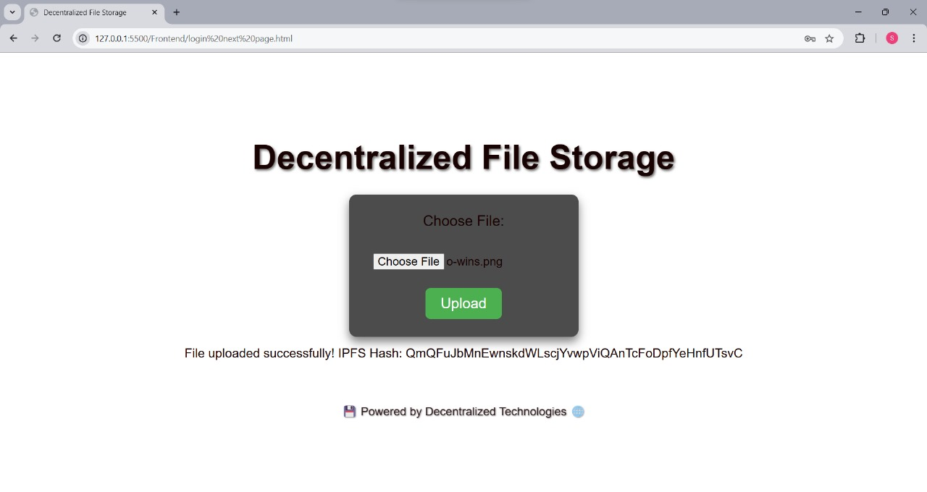
Fig : File Uploaded

Slide 11
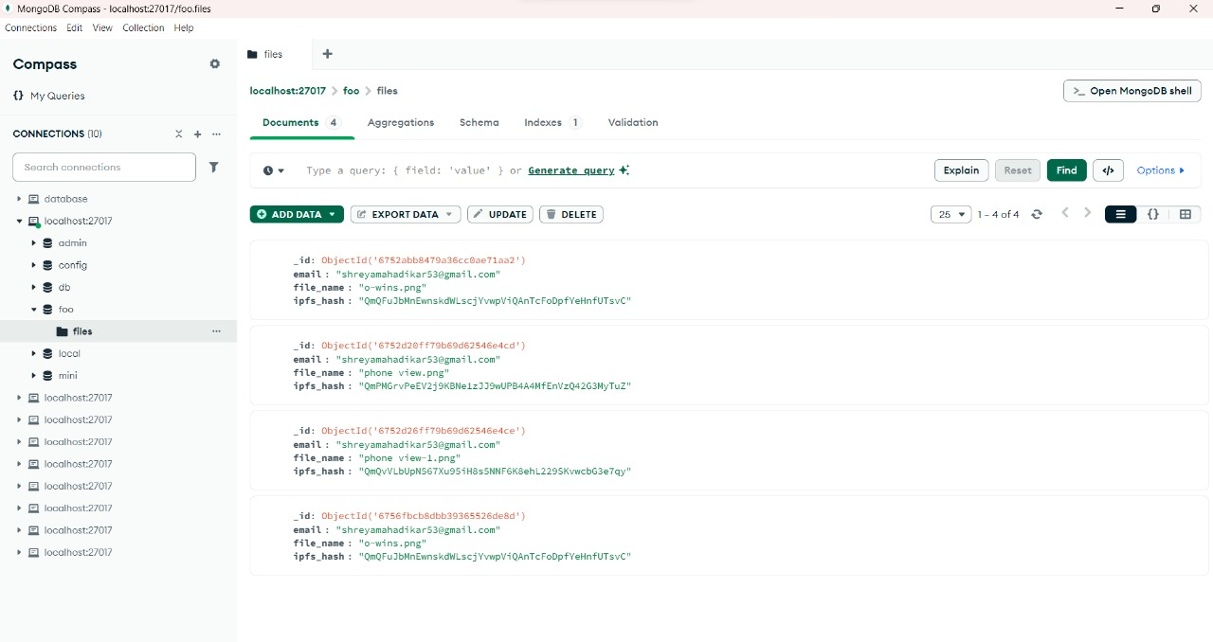
Fig :File Metadata Records with IPFS Hash in MongoDB

Slide 12
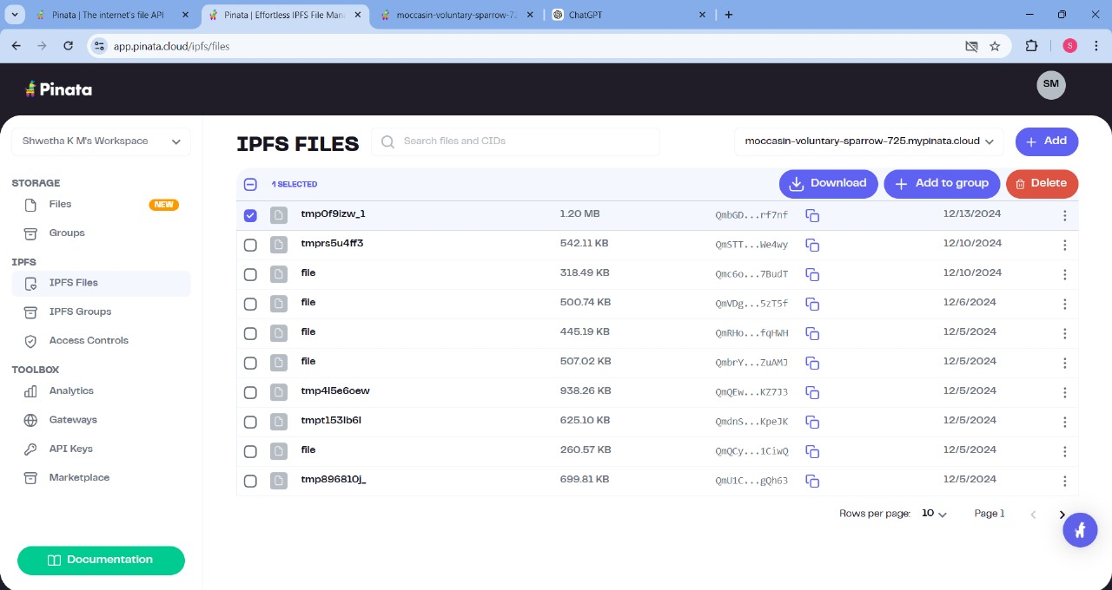
Fig : Files uploaded in Pinata

Slide 13
Outputs Achieved:
Successfully stored files on IPFS, ensuring decentralization.
Provided IPFS hashes for file retrieval, demonstrating transparency.
Achieved smooth communication between the frontend, backend, Pinata API, and MongoDB.
Visual Results:
Screenshots showing upload success with IPFS hash.
Demonstration of secure and efficient file retrieval process.
Achievements:
Enhanced data security and reliability.Delivered a scalable solution with minimal resource usage.

Slide 14
Challenges Faced
Integration Issues:
Initially faced difficulties integrating Flask with the Pinata API.
Solution: Thoroughly explored API documentation and optimized requests.
CORS Policies:
Encountered frontend-backend communication restrictions.
Solution: Configured Flask to handle cross-origin requests.
File Size Limitations:
Large files caused upload failures.
Solution: Introduced compression techniques and chunked uploads.

Slide 15
Future Work
Authentication: Implement advanced user authentication and file encryption for added security.
File Sharing: Allow secure, token-based file sharing between users.
Mobile App: Develop a mobile application for on-the-go access.
Enhanced Scalability: Support for handling larger files and multi-user operations.
Blockchain Integration: Explore integrating smart contracts for file verification.

Slide 16
Conclusion
Summary:
The Decentralized File Storage System successfully demonstrates the benefits of leveraging IPFS, Pinata, and MongoDB for secure, reliable file storage.
It addresses key challenges of centralized storage, offering a modern, decentralized alternative.
Takeaway:
The project lays a strong foundation for future enhancements in decentralized data management.
Impact:
Pioneering a future where data is more secure, accessible, and transparent for everyone.

Slide 17
THANK YOU!!!

